Slide 1
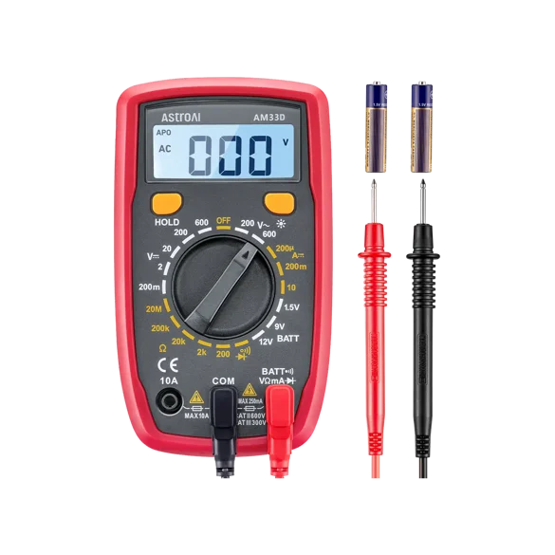
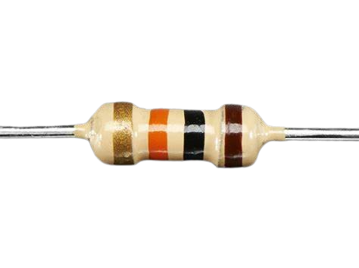

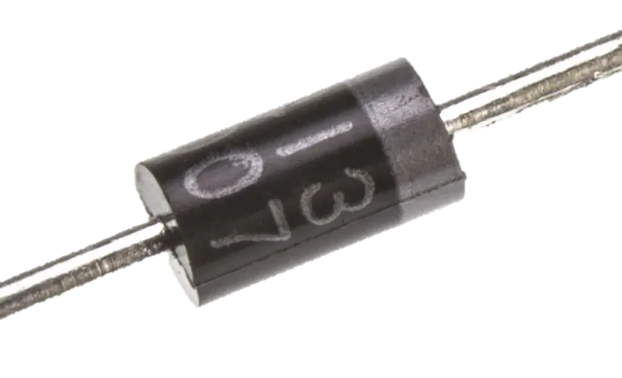
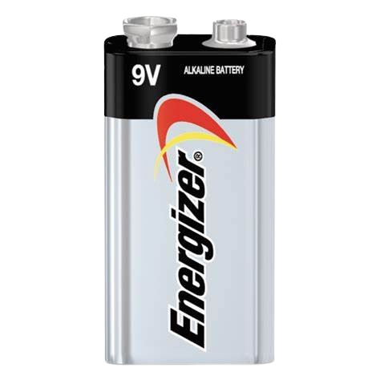
Buda Tech
Resistor
DMM
1N4007
diodes
VOLTAGE STABILISER
A DC voltage stabilizer, or voltage regulator,
is a device that maintains a stable DC voltage output
despite fluctuations in the input voltage or load current.
These stabilizers are crucial for protecting sensitive electronic
devices that require a precise and consistent power supply.
Battery
LOAD

Slide 2
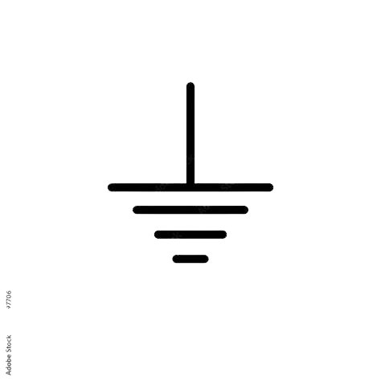
Buda Tech
R1
LOAD
VOLTAGE STABILISER
A DC voltage stabilizer, or voltage regulator,
is a device that maintains a stable DC voltage output
despite fluctuations in the input voltage or load current.
These stabilizers are crucial for protecting sensitive electronic
devices that require a precise and consistent power supply.

Slide 3
Buda Tech
R1
LOAD
Voltage drop of single diode = 0.7V
Total Voltage = 0.7 x 5 = 3.5V
Voltage of the Load = 3.5V

Slide 4
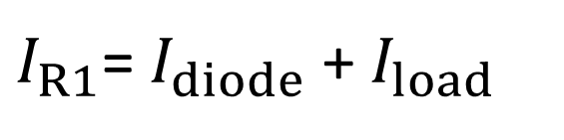



Buda Tech
R1
$$I_{R1}$$
LOAD
$$I_{diode}$$
$$I_{load}$$
1N4007
LOAD
$I_{R1}$= $I_{diode}$ + $I_{load}$

Slide 5
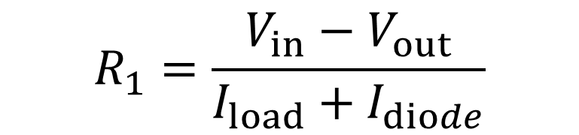
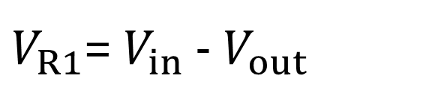
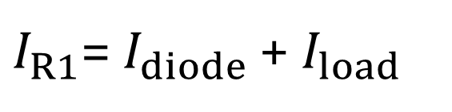
Buda Tech
R1
$I_{R1}$= $I_{diode}$ + $I_{load}$
LOAD
$V_{R1}$= $V_{in}$ - $V_{out}$
$$R_{1}=\frac{V_{in}−V_{out}}{I_{load}+I_{diode}}$$

Slide 6


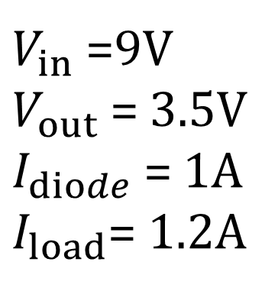
Buda Tech
$I_{R1}$= $I_{diode}$ + $I_{load}$
$V_{in}$ =9V
$V_{out}$ = 3.5V
$I_{diode}$ = 1A
$I_{load}$= 1.2A
$V_{R1}$= $V_{in}$ - $V_{out}$
$$R_{1}=\frac{V_{in}−V_{out}}{I_{load}+I_{diode}}$$
$$R_{1}=\frac{9−3.5}{1+1.2}$$
$$R_{1}=2.5Ω$$

Slide 7
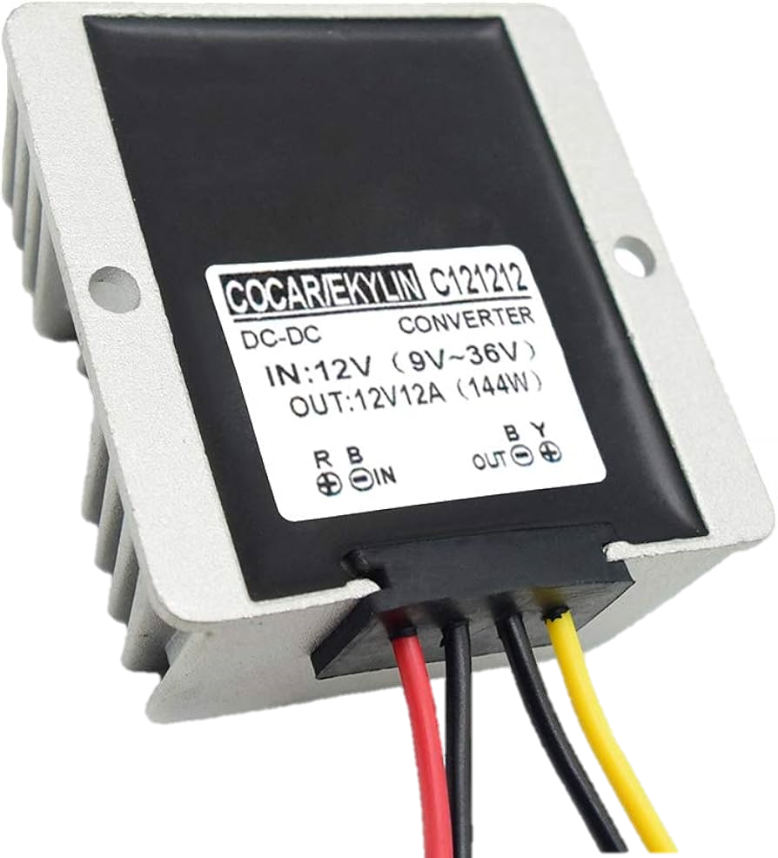
Buda Tech
12V
(9V -36V)
12V 12A
Input
Output

Slide 8


R1
VOLTAGE
STABILISER
LOAD
$$R_{1}=\frac{V_{in}−V_{out}}{I_{load}+I_{diode}}$$
USING 1N4007 DIODE

